Slide 1
A Review of Number Systems
TEXT2 (Assembly language for x86 processors) : Chapter one

Slide 2
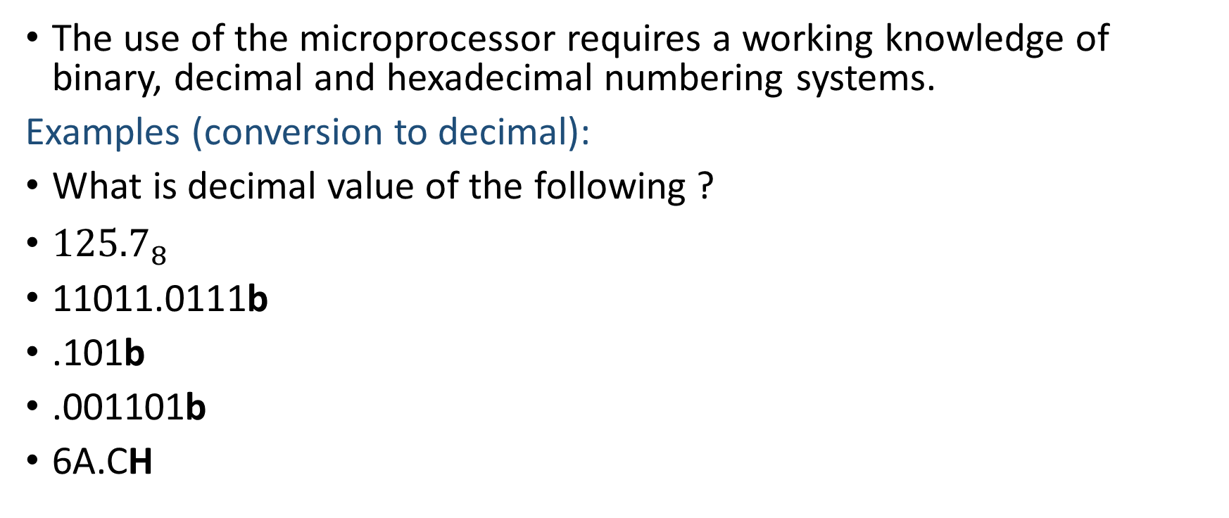
The use of the microprocessor requires a working knowledge of binary, decimal and hexadecimal numbering systems.
Examples (conversion to decimal):
What is decimal value of the following ?
${125.7}_{8}$
11011.0111b
.101b
.001101b
6A.CH

Slide 3
Examples: Conversion from decimal
What is 20 in base 2?
What is it in base 8?
What is 106 in base 16?
Convert the number 0.125 to:
Binary
Octal
Hexadecimal

Slide 4
Binary-coded Hexadecimal (BCH)
BCH is used to represent hexadecimal data in binary code.
It allows for easy conversion between binary and hexadecimal.
Generally, a BCH number is a hexadecimal number written so that each digit is represented by a 4-bit binary number.
Examples
Convert 29FC to binary.
Convert 1000 0011 1101 . 1110 to hexadecimal.

Slide 5
Signed Integers
A signed integer can have either a positive or a negative value.
In the x86 processor architecture, the MSB indicates the sign: 0 is positive and 1 is negative.
Humans simply put a – sign in front of a number to show it is negative. What about the computer.
Two’s-complement representation is used (1’s complement was used in the past)
This representation is based on the mathematical principle that the two’s complement of an integer is its additive inverse.

Slide 6
The two’s complement of a binary integer is formed by inverting (complementing) its bits and adding 1.
What is the two’s complement representation of 00000001?
How will -1 be represented in an x86 processor using 8 bits?
The same principles can be applied to all number systems.
What is the two’s (or sixteen’s) complement of the following hexadecimal numbers?
95C3, 5CC?

Slide 7
Converting Signed binary to decimal
The following algorithm can be used to calculate the decimal equivalent of a signed binary integer:
If the highest bit is a 1, the number is stored in two’s-complement notation.
Create its two’s complement a second time to get its positive equivalent.
Then convert this new number to decimal as if it were an unsigned binary integer.
If the highest bit is a 0, you can convert it to decimal as if it were an unsigned binary integer.
Example: What is the value of the signed binary 11110000 in decimal?

Slide 8
How would you convert a signed Decimal to Binary?
How would you convert a signed Hexadecimal value to Decimal?
How would you convert a signed Decimal to Hexadecimal?
NOTE
You can tell whether a hexadecimal integer is positive or negative by inspecting its most significant (highest) digit.
If the digit is ≥ 8, the number is negative; if the digit is ≤ 7, the number is positive. For example, hexadecimal 8A20 is negative and 7FD9 is positive.

Slide 9
If computers only store binary data, how do they represent characters?
They use a character set, which is a mapping of characters to integers.
The two standards in use today are ASCII and Unicode Data.
In ASCII, a unique 7-bit integer is assigned to each character.
Examples
‘F’ is represented as 41h while ‘1’ is represented as 31h
ASCII strings are stored in memory as a succession of bytes containing ASCII codes.

Slide 10
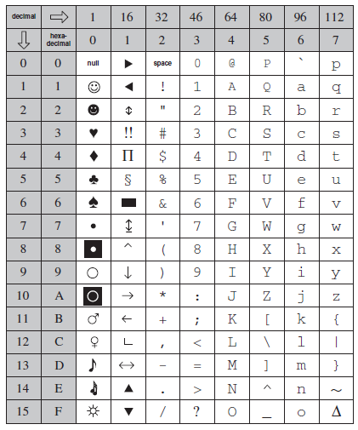
A PART OF THE ASCII TABLE

Slide 11
There has been a need for some time to represent a wide variety of international languages in computer software.
As a result, the Unicode standard was created as a universal way of defining characters and symbols.
It defines codes for characters, symbols, and punctuation used in all major languages.
Three encoding forms are available in Unicode: UTF-8, UTF-16 and UTF-32

